Slide 1
APTP - Dev Tools Overview
02/02/2015

Slide 2

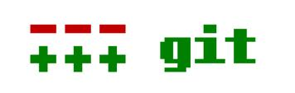




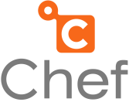


Tool Overview
Tool Overview
These are the various tools used throughout the CI process.
Code Store Repository
DB Deployment
Build and Deployments
Code Analysis
Artefact Management and Repository
Integrated Development Environment
Application monitoring
Infrastructure automation framework

Slide 3

Development Architecture – Development Tools
Code Store Repository
Database Deployments
Code Review Statistics
Build and Deployments
Lightweight Database Migration tool which integrates with version control
Supports common DBMS including Oracle, SQLServer, MySQL, DB2 and PostgreSQL
Easy to configure and administer
Execution through Command-line, Ant or Maven
Code Review Management
Sonar reports on quality and high level metrics
Reads and Analyses code for high-level overview
Supports over 10 languages
Dashboard based Web UI
Permissions by projects/role
Vast amount of Plugins for extensibility
Jenkins is an open source continuous integration tool
Build/Test software projects continuously
Build/Deploy Management
Extendable through plug-ins (Git/Gerrit/Sonar)
Monitor execution of externally-run jobs (cronjobs etc.)
Minimises build time compilation errors
LDAP authentication
Web based UI
Open source version control system
Atomic commits. One transaction to add/update/delete files
Promotes grouping related changes together in one commit to easily identify and revert
Integrates with multiple platforms including Windows Explorer via Tortoise and leading IDEs (Eclipse, IntelliJ)
Fast and flexible update/commits. All tasks can be done from any level easily (updates, commits, merges, reverts, etc)

Slide 4
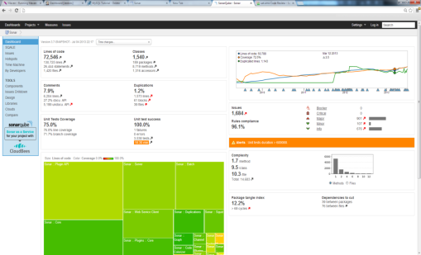
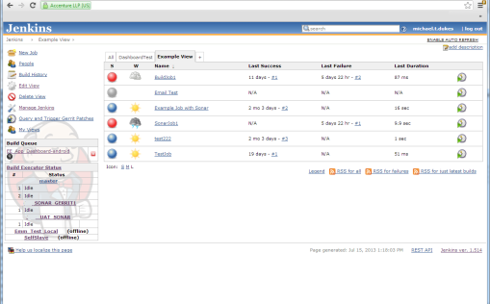
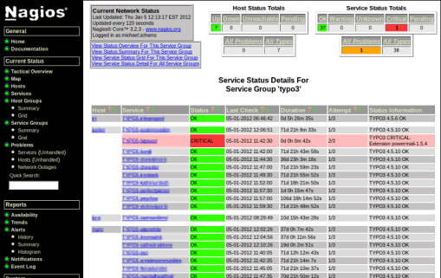
Development Architecture – Development Tools
Artefact Management and Repository
Infrastructure and Service Monitoring
Integrated Development Environment
Nexus is an open source free repository manager software provided under the eclipse public license
Provides the ability to proxy a remote repository and cache artifacts saving both bandwidth and time required to retrieve a software artifact from a remote repository
Provides the ability the host a repository providing an organization with a deployment target for software artifacts
Integration with LDAP
Nagios is a popular open source computer system and network monitoring application
New scripts can be created by our experts for any application/scenario to ensure effective monitoring
Nagios can be used at scale to monitor 1000s of servers
Using custom DCS scripting, multiple global datacentres can be monitored globally, rather than at a per site level
DCS has developed an Operations Team dashboard that provides almost real-time updates
Eclipse is the “De Facto” IDE for java development
It is open-sourced and supports other development languages
Its plugin extensibility allows the CI process to be used within one tool
Eclipse supports team collaboration via plugins and tools such as code repositories
Contains popular IDE features including debugging, project management and testing
Sonar
Jenkins
Nagios

Slide 5
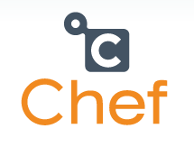
Chef Intro
What is Chef?
Chef is a systems and cloud infrastructure automation framework that makes it easy to deploy servers and applications to any physical, virtual, or cloud location, no matter the size of the infrastructure
Chef is built to address the hardest infrastructure challenges. By modeling IT infrastructure and application delivery as code
Chef is a configuration management tool written in Ruby and Erlang. It uses a pure-Ruby, domain-specific language (DSL) for writing system configuration "recipes"

Slide 6
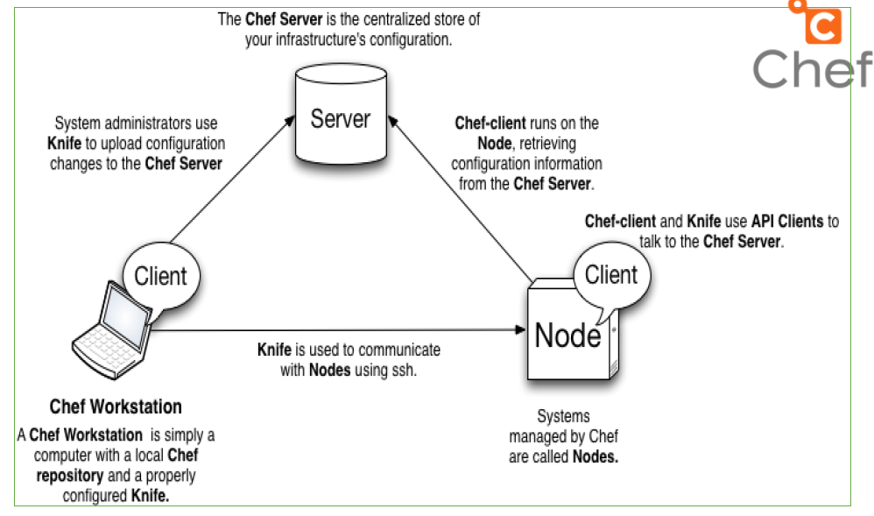
Chef Intro
Chef comprises three main elements: a server, one (or more) nodes, and at least one workstation.
The server acts as a hub that is available to every node in the organization. This ensures that the right cookbooks (and recipes) are available, that the right policies are being applied, that the node object used during the previous chef-client run is available to the current chef-client run, and that all of the nodes that will be maintained by the chef-client are registered and known to the server.
The workstation is the location from which cookbooks (and recipes) are authored, policy data (such as roles, environments, and data bags) are defined, data is synchronized with the chef-repo, and data is uploaded to the server.
Each node contains a chef-client that performs the various infrastructure automation tasks that each node requires.

Slide 7
Chef Intro
All server configurations on the APTP Test Environment will be controlled via Chef with controlled users provided with access to modify server configuration in dev environments.
The Chef client will be installed on each server in the Dev/Test/Production Environment and any future configuration changes will be made to the necessary Chef Cookbook on the Chef Server.
The Chef client will then be invoked and will pull the necessary configuration changes from the Cookbook on the Chef Server. An application’s Chef Cookbook will serve as a baseline for the application’s version and associated configuration.
Chef cookbooks will run through the test lifecycle (dev/test/pre-prod/prod) in the same manner as code to ensure any amendments to cookbooks are thoroughly tested before being promoted

Slide 8
AWS High Level Network Architecture
Users will access the dev tools and any applications via the Reverse Proxy server
Public Subnet has access to the Internet and is accessible from certain ports (e.g. 443,22,80)
Private Subnet has access to the Internet(Not direct, but via Reverse Proxy) and is NOT accessible from anywhere, except the Reverse Proxy

Slide 9
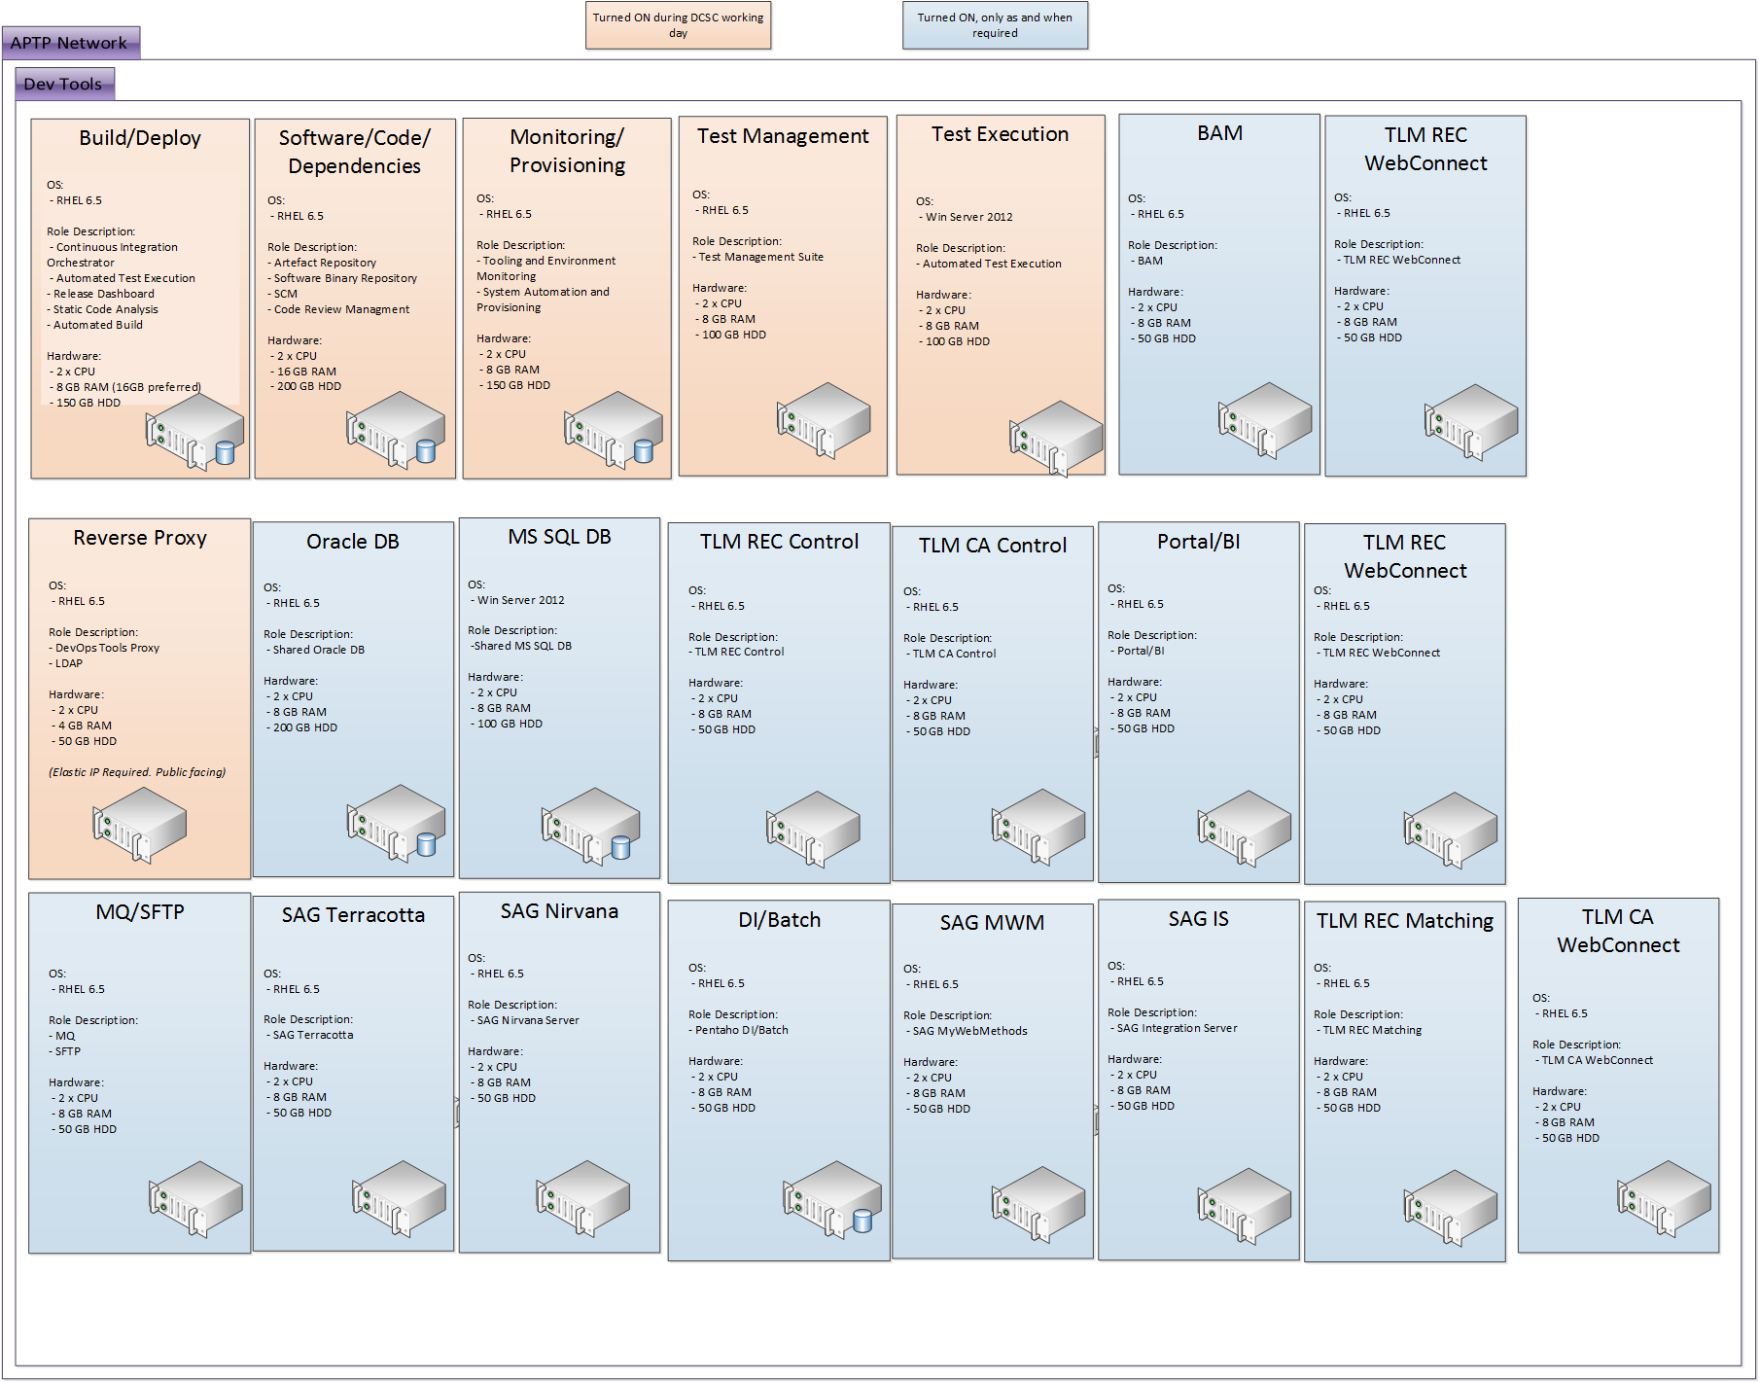
AWS Landscape

Slide 10
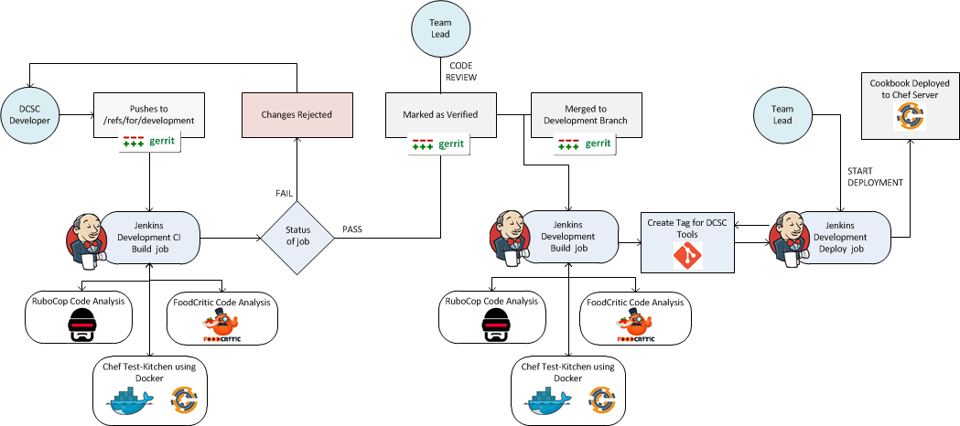
Environment Management Improvements
Internal DCSC Chef CI Pipeline
The following pipeline will be used by the DCSC team to create/update any Chef cookbooks (installation/deployment scripts)

Slide 11
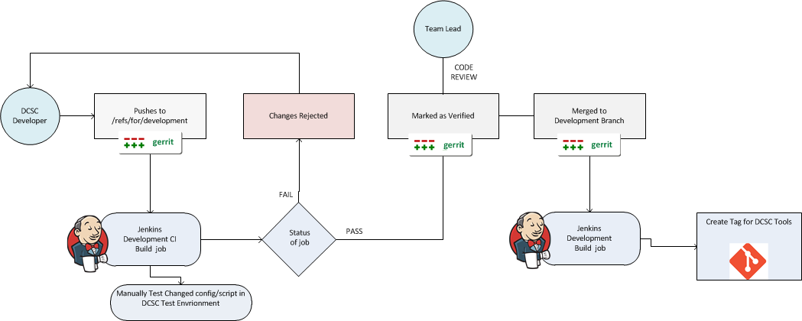
Environment Management Improvements
Internal DCSC CI Pipeline (For Non-Chef items)
The following pipeline will be used by the DCSC team to create/update any DCSC managed scripts/configuration that is not part of Chef

Slide 12
Cost Estimates
This AWS cost estimate has been based on the following factors:
Servers sized according to the diagram shown within this deck
Servers are located in the EU Amazon region
Servers usage is 12 hours per day for the core servers and 3 hours per week for the on demand test servers.
Expected network usage has been taken into account
200GB disk drive per server
Total Estimated Cost per month: $569.81

